Slide 1

2025 Grant Process
Notes:
Hello, thank you for joining us virtually for an introduction to the 2025 GiVE 365 Grant Process.
GiVE 365 is a different type of grant program, and this introduction to how it works should help you figure out if your organization might be a good applicant.

Slide 2
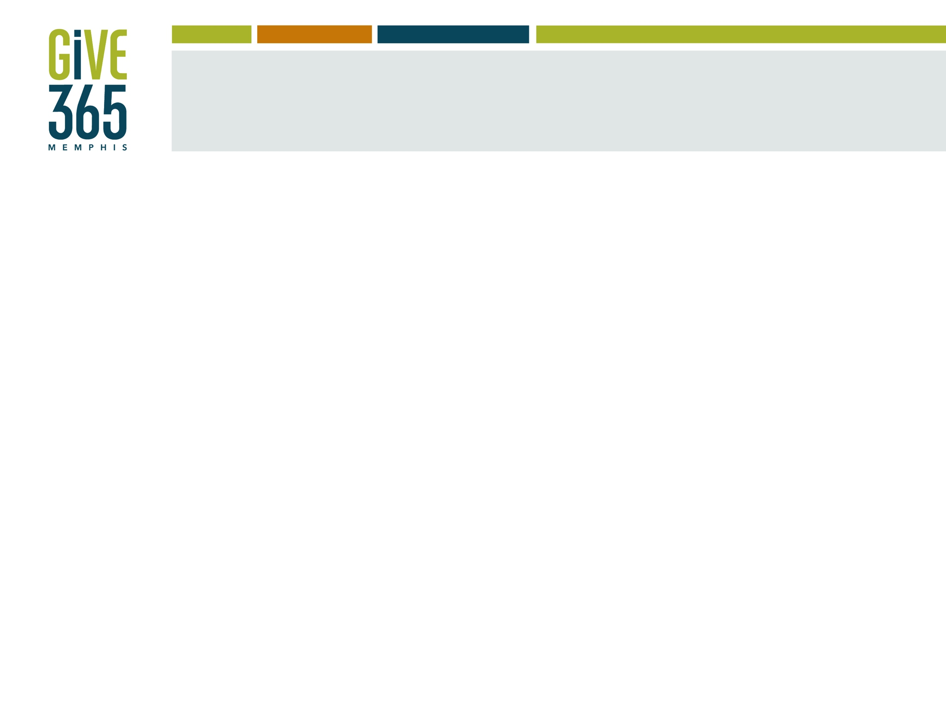
Agenda
Introductions
Overview of Community Foundation
What is GiVE 365?
Grant theme
Requirements for applicants
Application and Evaluation tool
Important dates
Grants portal
Notes:
For introductions I'm going to ask that you simply put your name and organization in the chat.
I'll start by telling you a little bit about the Community Foundation and the GiVE 365 program.
We’ll look at the eligibility criteria for GiVE 365 grants.
Then we’ll go through the application and what reviewers will be looking for.
We’ll look at the timeline for the process and talk some about grant finalists.
Lastly, we’ll review the online Grants portal where you’ll be submitting your application.

Slide 3







What is a community foundation?
Charities
Notes:
We are one of about 900 community foundations in the United States, all of which are different from each other, but all of which are set up for similar reasons. Our basic mission is to improve our community through philanthropy. Like other community foundations, we
raise funds for charitable purposes,
make grants to nonprofit organizations, and
act as a catalyst to improve the quality of life in its community.
The Community Foundation of Greater Memphis is the largest philanthropic foundation in the Memphis area. Currently we have a little under $1 billion in assets. In FY2024 which ended in April for us, $120M in grants went out our doors to nonprofits in the Memphis area and some around the country. The overwhelming majority of that $120M was directed to nonprofits by the 1200+ individuals, families, businesses, and nonprofits that have charitable funds here at the Community Foundation.
If you’ve received a check from us, it likely came from one of those charitable funds – meaning the money was granted out to your organization at the request of an adviser to that fund. Managing the philanthropy of our donors who have funds with us is really the largest part of what we do. Donor-advised fund holders recommend grants to nonprofit organizations based on their own areas of interest and impact. Donors typically do not accept requests from nonprofit organizations.
We are aware that nonprofits are eager to know the best way to share their mission and work with Community Foundation donors. While there are no formal channels to make these introductions, we are committed to connecting the nonprofit community with our donors and are currently working on how to best support both sides of our work. Hold us accountable to the stating that there will be more opportunities to get you, your organization, and your work in front of some of the most charitable in out community.
Again majority of the funds that go out of our door are donor-directed grants and are non-competitive. They are not grants that nonprofits can apply for. All of our competitive grants that a nonprofit can apply for can be found on our website.
There are a few vehicles for this type of grant, but today we’ll talk about GiVE 365.

Slide 4
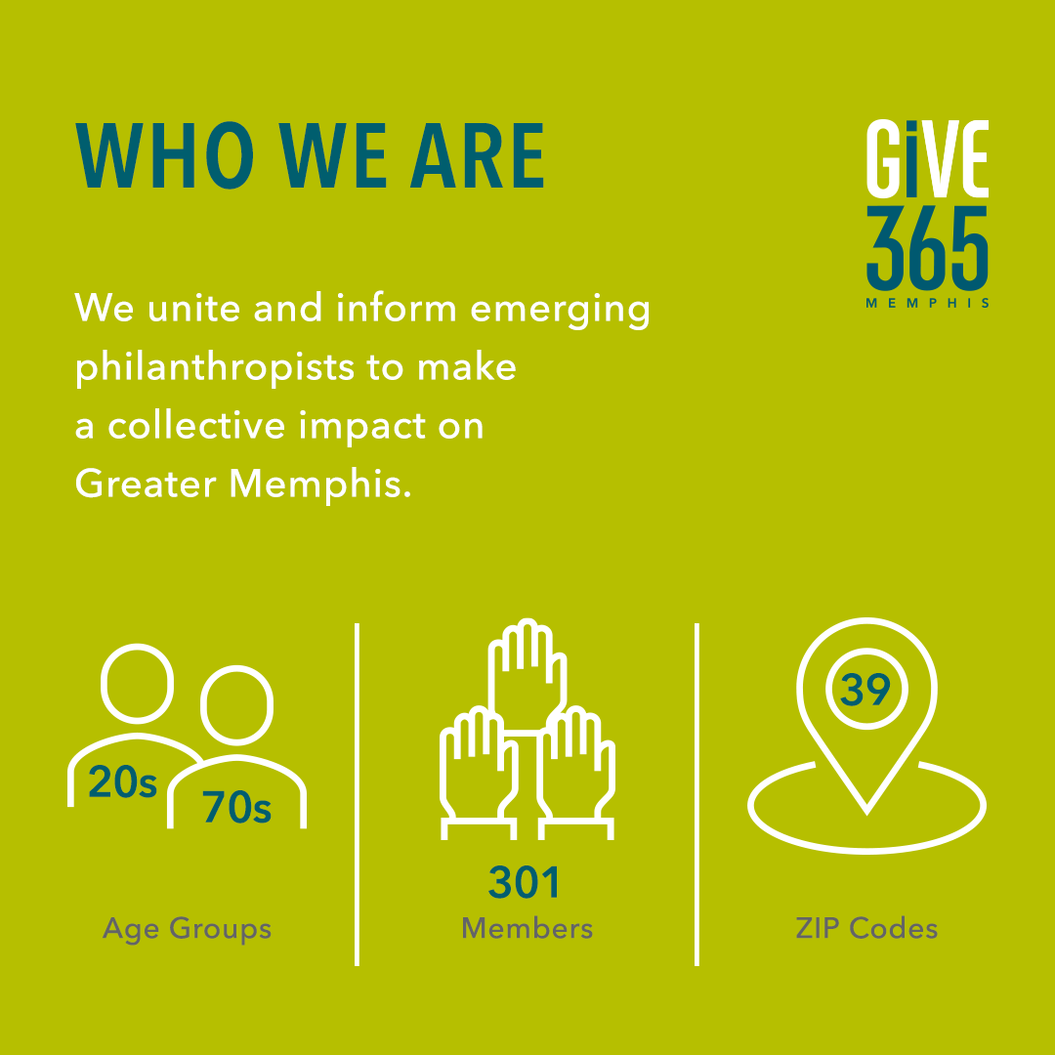
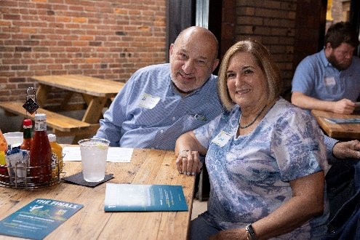
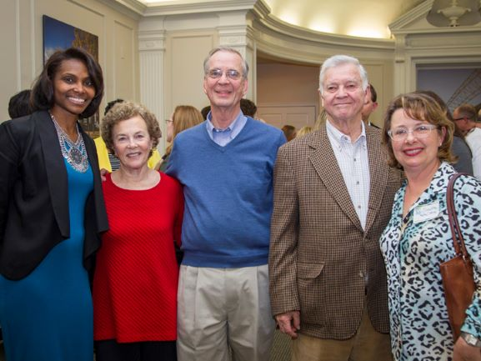
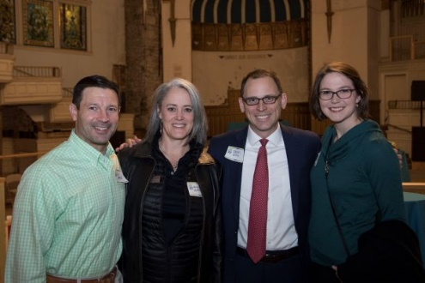
What is GiVE 365?
Notes:
The Community Foundation’s mission is to strengthen our community through philanthropy, and in 2010 we developed GiVE 365 to further this mission with people who love Memphis and want to work with others to find ways to make it better.
The mission of GiVE 365 is to unite and inform emerging philanthropists to make a collective impact on Greater Memphis.
We currently have around 301 members from zip codes all over the city. We have people in their 20s who are just starting to give, people in their 70s who appreciate a new way to contribute, and all ages in between - so membership really is for everyone.

Slide 5
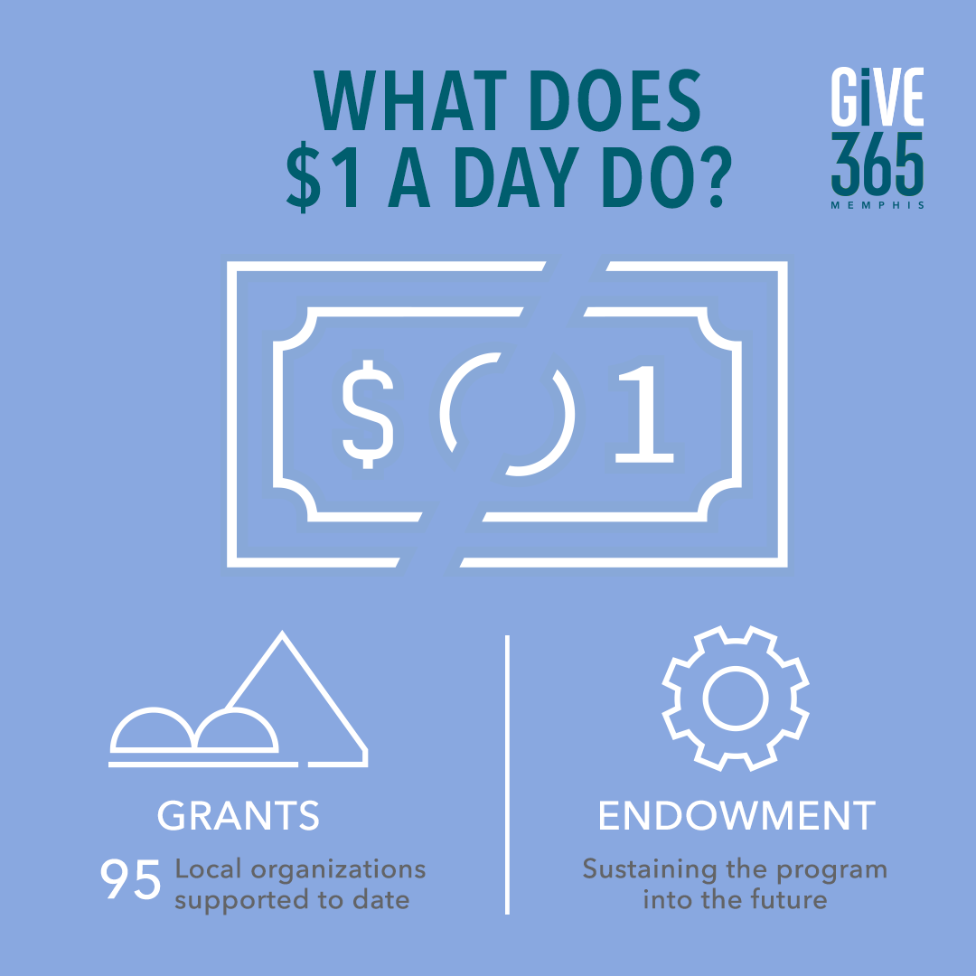

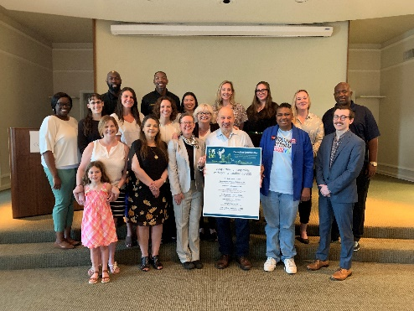
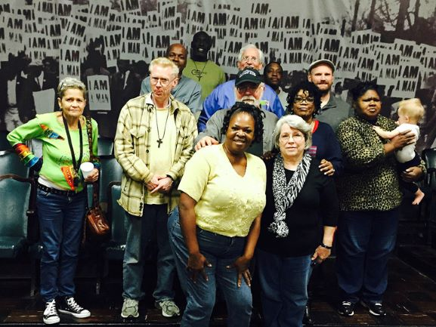
How are the dollars spent?
Notes:
How do you become a member? At a basic level, members give $365, or a dollar-a-day, each year. That donation can be paid in either one lump sum or donated monthly. Half of the donation goes towards grants made that year, and the other half goes to an endowment that is invested and will sustain the program into the future.
Last year, together our members gave out $57,600 in grants to nonprofits – which was made up of their annual donations PLUS interest that was kicked off from our endowment.

Slide 6
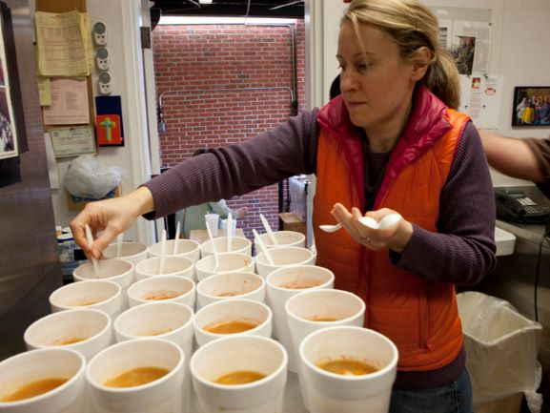
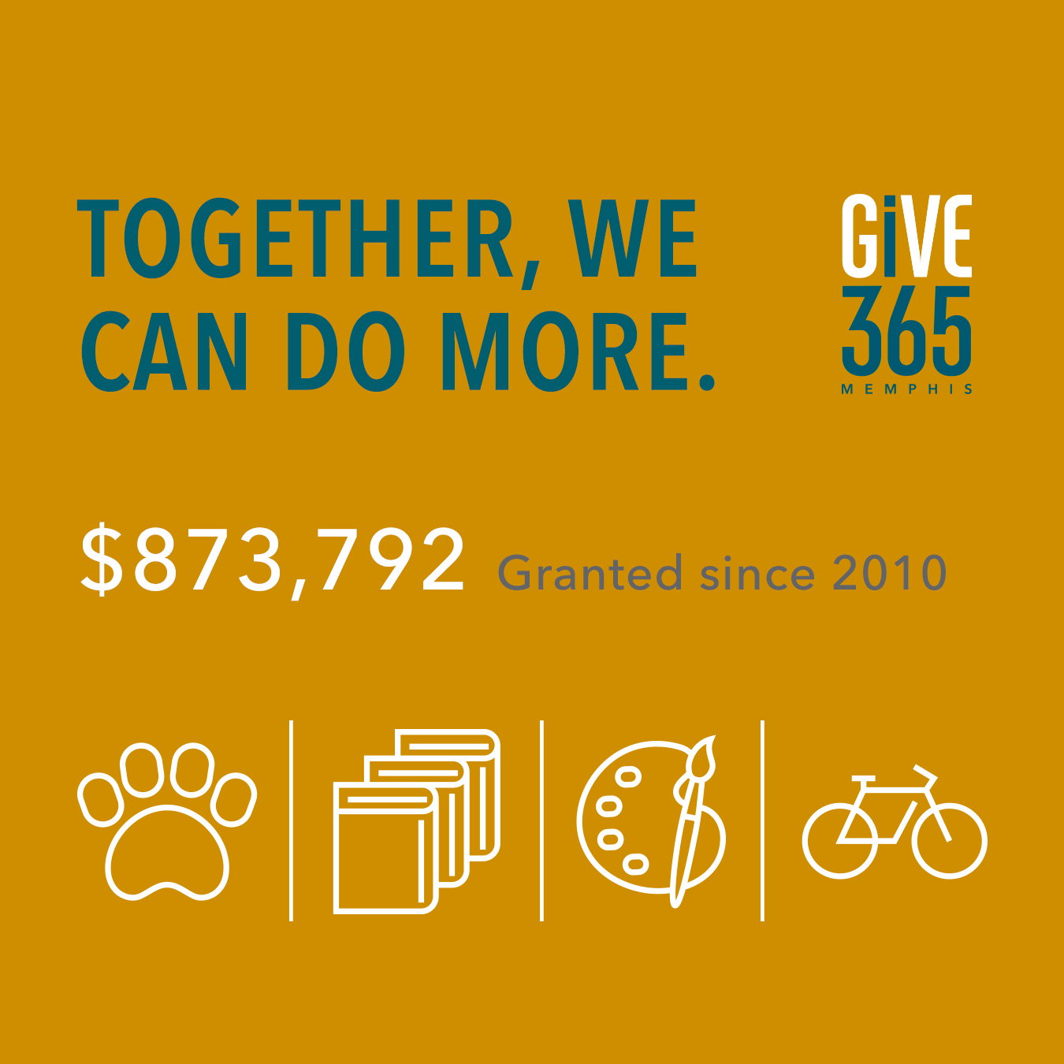

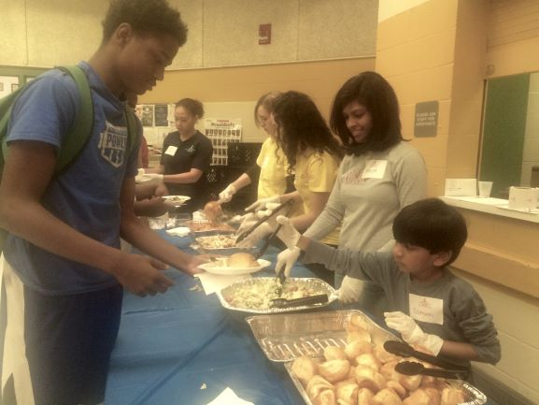
Impact since 2010
28% of members
get more involved
Notes:
GiVE 365 is a program that helps support our belief that anybody can be a philanthropist. And it also allows for collective giving – and collective impact.
Individually GiVE 365 members have given $365 but the tangible results of members’ collective impact is the $870,000+ dollars they have granted to 95 distinct nonprofits in the past fifteen years.
Also cool is that over half of our members have reported that they have given additional dollars to a nonprofit that they met through GiVE 365, and some have volunteered with grantees too.
The heart of GiVE 365 is the grantmaking to local nonprofits so…

Slide 7
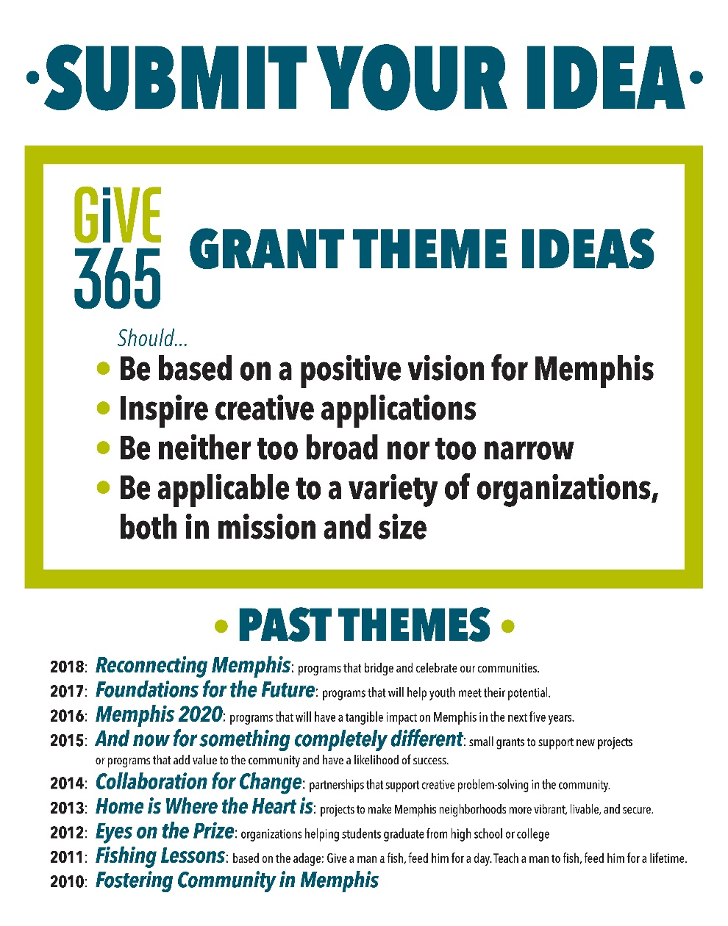
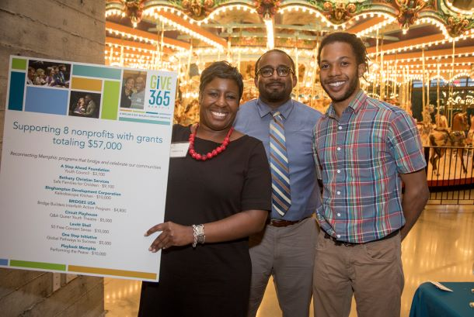

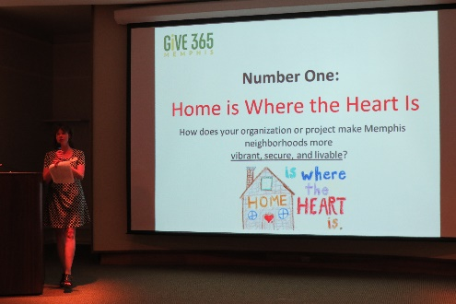
How does the process work?
Notes:
The great thing about GiVE 365 is that members can choose how involved they want to be. We have a variety of ways that GiVErs can engage with through their membership. And it all ties to their grantmaking. So every year our grant round has a theme. We invite members to give us an idea for a grantmaking theme if they have one. Members can then vote on their favorite theme idea in the late fall, and the theme with the most votes is announced in December.

Slide 8
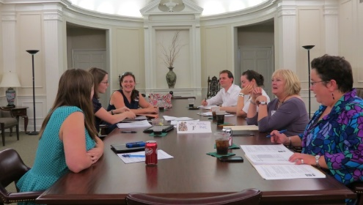
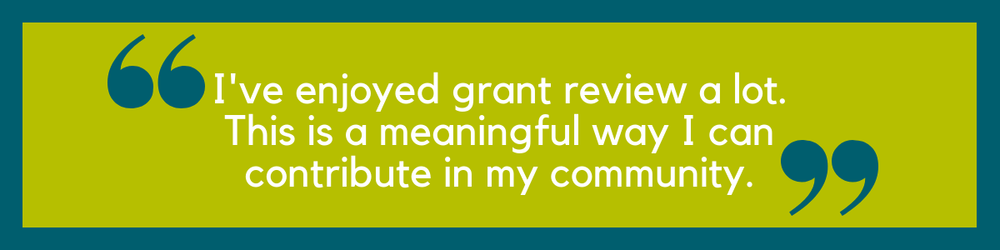
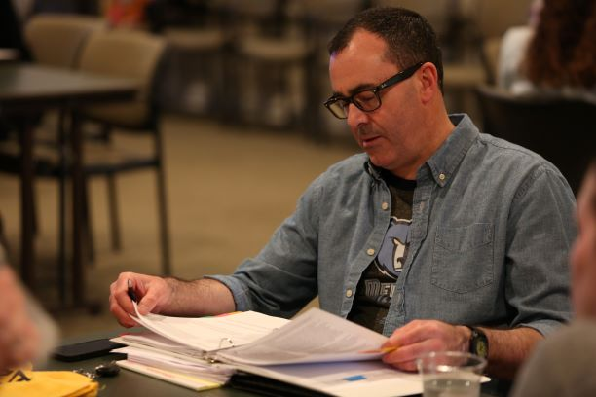
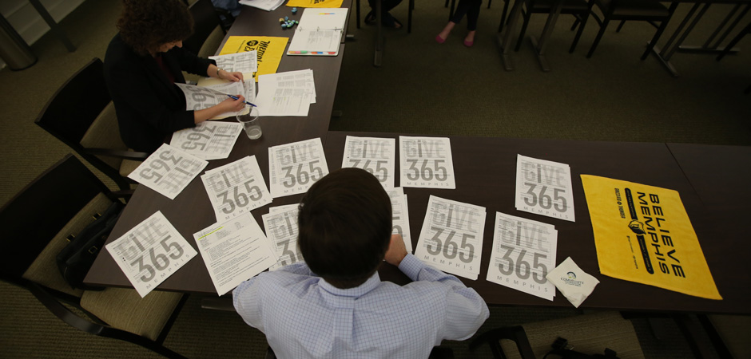
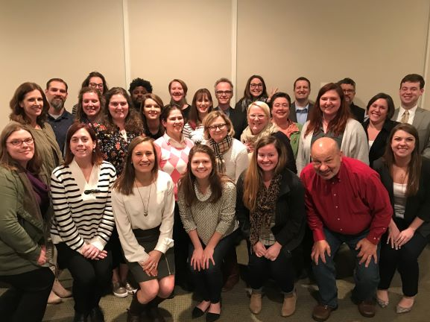
Grant review
Notes:
Once the grant theme is announced, GiVE 365 members can again choose how active they want to be in the grantmaking process. Many of our members do choose to join a grant review team. After nonprofits submit their applications based on the year’s theme, these grant review teams research the applicants in February and March and narrow them down to a slate of finalists. For a little context in the 2024 grant cycle, 15 finalists were chosen from a little over 40 applications.

Slide 9
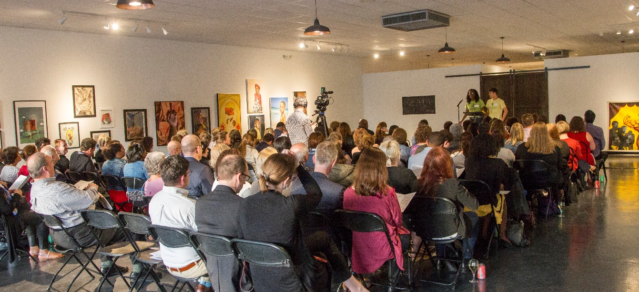
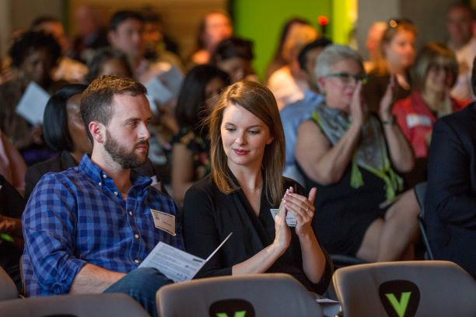
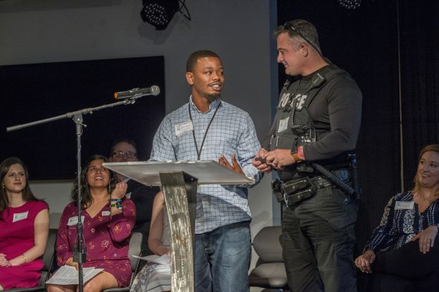
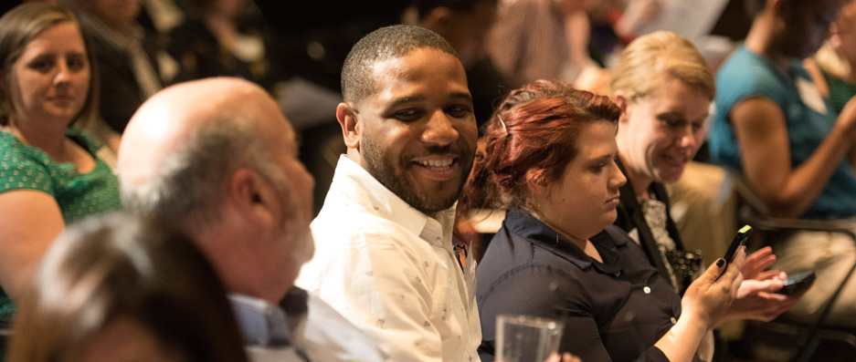
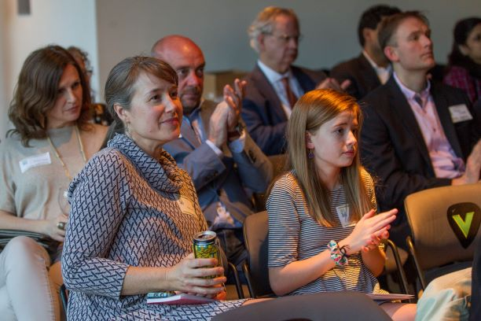
The Finals
Notes:
Once the finalists are chosen, we have our biggest event of the year, called The Finals. The selected applicant finalists present their projects to the membership in quick three-minute pitches. Following that event, members vote online for their top 5 organizations.
The grantees who are awarded funding are announced in May at the Community Foundation’s Annual Meeting. And then members get to see a year’s worth of impact and progress by engaging with the grantees in various ways. Community Foundation staff works with grantees to keep members updated on the status of the grants in various ways throughout the year.
Hopefully this all sounds great, and makes you more excited about applying for a grant from GiVE 365! So who should apply?

Slide 10

2024 Grant Theme
Notes:
The number one criteria for GiVE 365 grants is that they support the annual grant theme. In case you’ve missed it, the theme is:
Roughly $60k will be available; average grants in the past rounds have been around $5,000 with the highest being $15,000 and the lowest being $2500
Our 2025 theme, Grow and Lead, focuses on nurturing children and youth by equipping them. We believe these foundational areas are key to shaping resilient, compassionate, and future-ready leaders who can navigate challenges and contribute to thriving communities.
Imagine a community garden where teens not only learn how to grow food but also develop teamwork, problem-solving, and leadership. Or a mentoring program where young people strengthen their emotional resilience while exploring the cultural legacies that shape their identity. These are the kinds of initiatives that align with our vision.
Essential Life Skills: Practical skills such as financial literacy, communication, or leadership.
Emotional Intelligence: Programs emphasizing empathy, mental wellness, or conflict resolution.
Cultural Heritage Exploration: Opportunities for youth to engage with history, arts, or traditions, fostering identity and belonging.
Collaboration and innovation are highly valued. Organizations don't need to have expansive budgets to apply, as smaller grassroots initiatives are equally important.
Essential Life Skills:
Workshops teaching teens how to write resumes, budget, or start a small business.
Community-based robotics programs encouraging problem-solving and teamwork.
Leadership academies for youth to practice public speaking and conflict resolution.
Emotional Intelligence:
Peer mentoring programs pairing older and younger students to build empathy and reduce bullying.
Art therapy sessions addressing trauma or mental health challenges.
Initiatives teaching mindfulness practices or restorative justice in schools.
Cultural Heritage Exploration:
Afrocentric dance classes or storytelling circles exploring cultural identity.
Projects connecting youth with elders to document oral histories.
Multicultural festivals led by youth, highlighting different traditions and their significance.

Slide 11
Requirements for applicants
Projects must fall under the grant theme
501(c)(3) organization or a 501(c)(3) fiscal agent
An in progress LIVEGIVEmidsouth.org profile
Grant funds should be used within one year
Project must serve area in or around Memphis
Notes:
Beyond supporting the annual grant theme, your organization:
Grants can only be made to active 501(c)3 organizations. (fiscal agent ok with MOU – contact Aerial first; email MOU)
The applicant nonprofit (or fiscal agent) must have an in progress LIVEGIVEmidsouth profile.
Grant funds should be used within one year. (May-April)
Project must serve area in or around Memphis
If a church is present: Programs that are run by houses of worship must be accessible to community members outside the congregation and may not be religious in nature

Slide 12
LIVEGIVEmidsouth
Notes:
LIVEGIVEmidsouth is the only community information system of its kind in the Mid-South region. LIVEGIVEmidsouth is a free, online community information system that houses 180+ indicators from public data sources and a directory of nonprofit organizations working in our region.
The LIVE side of the platform is an online dashboard that uses data from a variety of public sources (such as American Communities Survey, Shelby County Health Department, and Tennessee Department of Education) to show objective current information on many different livability and health factors in Greater Memphis. And the GIVE side is a directory that lets nonprofit organizations provide information about their mission, staff, major programs, and finances. People can search profiles and find groups that are working on issues important to them.
The Community Foundation and several other funding partners require and encourage having a LIVEGIVE profile to be sure that your organization has the

Slide 13


Requirements for applicants
If your organization does NOT have a profile, go to LIVEGIVEmidsouth.org and:
  Create an account and begin working on profile
If your organization DOES have a profile:
  Make sure your profile is current
  Be aware of any requests for updates throughout the application and grant cycle
  Grant requirement to update profile within 60 days
You’ll know your profile is published and good to go if it has this:
Notes:
The first step to creating a profile is to go to LIVEGIVEmidsouth.org and register for an account. Once your account is authorized by our staff, you can begin working on the profile. Start working on the profile NOW to make sure you’ve given yourself plenty of time.
One-on-one coaching sessions are available.
If you have any questions, email or call Randy but DO NOT WAIT UNTIL THE LAST MINUTE TO BEGIN WORKING ON THIS.
If your organization is awarded, we talk about the timeline to be published before being funded.

Slide 14
Application details
Application
  Detailed description of the program and how it addresses grant theme
  Description of how the grant funds will be used
  Staff/board representation
  Definition of success and how it will be determined by the end of the grant period
Notes:
Go through sample app + scoresheet
The scoresheet mirrors the questions in the application
Scoresheet gives direction as to what kind of program we’re looking for. (Gives guidance to grant review teams but is not the final word.)
Scoresheet criteria are loosely listed in order of importance with most important criteria listed first

Slide 15
Important dates & deadlines
February 7: LIVEGIVEmidsouth profiles must be in progress
February 14: Application must be submitted online
March 28: Email notification to Grant Admins regarding application status
Notes:
GiVE 365 members will review eligible applications and choose a group of finalists.
The person listed as your “Grant Admin” will be notified via email as to whether or not your application has been chosen as a finalist by Wednesday, March 20
If you are a finalist, the application will be available for public view on our website. You may be contacted with questions by a review team member.

Slide 16
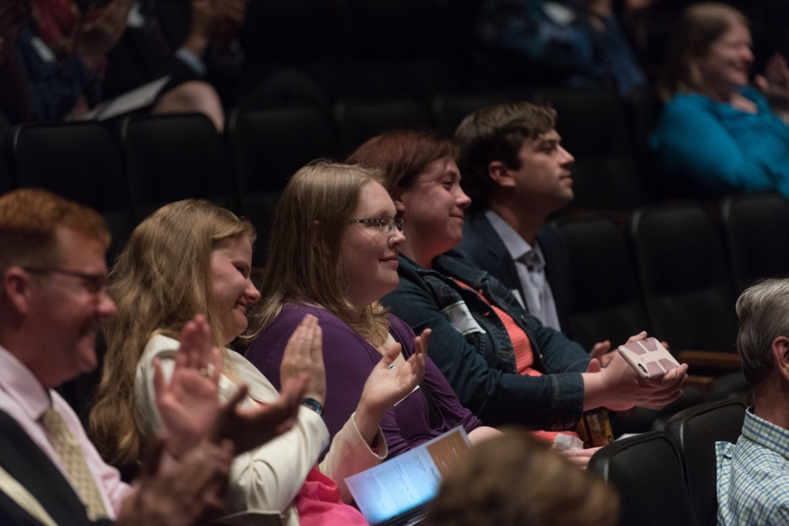
Finals and beyond
Early April
Early May: Finalists notified about awards
Mid-May: Awards announced at Community Foundation Annual Meeting
Two grant updates
Events
Notes:
Finalists must record a quick, 3-minute video that will be shown to the GiVE 365 membership at the Finals. A representative from the organization should also plan to attend. The presentation can be done by a staff or board member, or even a beneficiary of the project, but it is required. If you are a finalist, we will provide much more information than is necessary for this info session.
GiVE 365 members will vote online and grant awards will be announced at the Community Foundation's Annual Meeting in May. (Grantee attendance is optional.)
Grantees are required to submit very brief quarterly updates that will be shared with GiVE 365 members via our website, social media pages, and other points of contact.

Slide 17
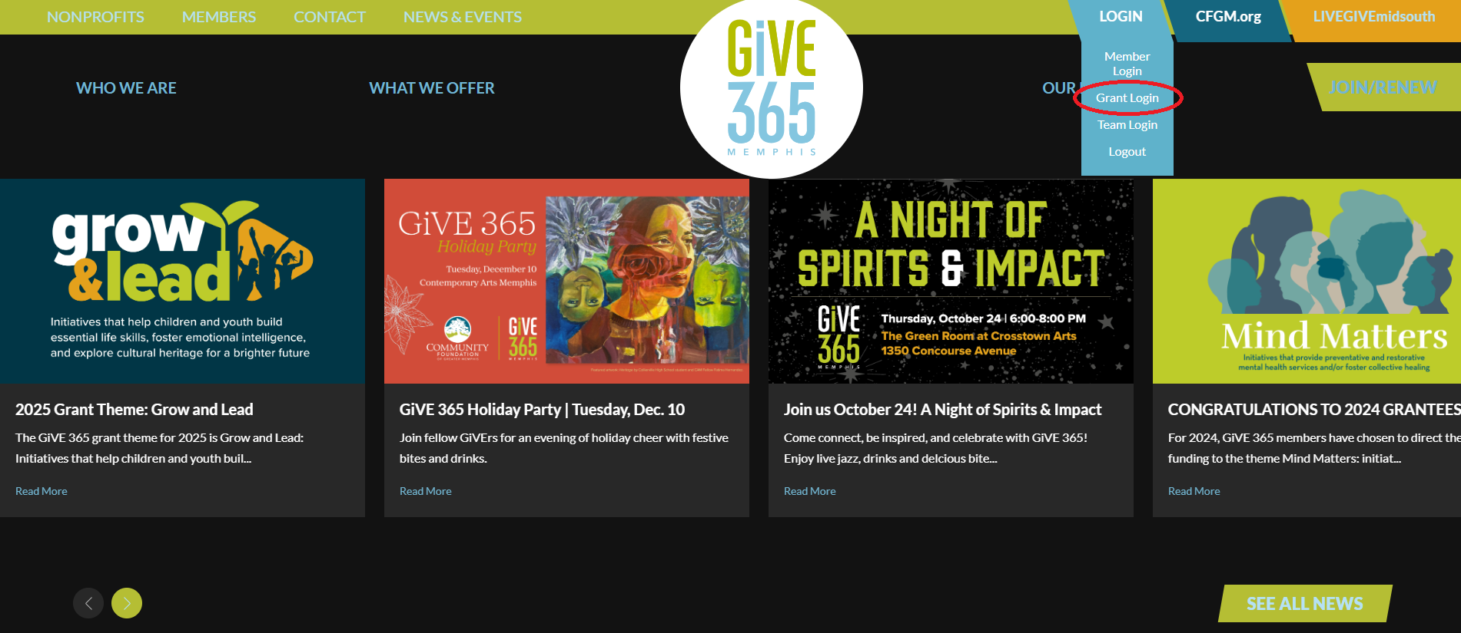
Accessing the Grants portal
give365memphis.org
Login > Grant Login
Notes:
Now, let’s walk through how to access the Grants portal, including how to register as a Grant Administrator and apply for a grant. (switch to other presentation provided as handout)
While it does take a minute to get registered, in the long-run this portal should be beneficial to you and your organization because it will house all in one place:
-your organization and personal contact information
-all grant applications submitted by you (or others!) in your organization
-follow-up grant reports related to an approved application
-matching grant request forms
-a history of grant payments to the organization you’re connected with
-MORE THAN ONE PERSON AT YOUR ORG CAN HAVE A LOGIN (RECOMMENDED)

Slide 18
Questions?
Aerial Ozuzu
Director of Community Impact
aozuzu@cfgm.org
(901)722-0022
Notes:
Questions?

